Slide 1
Multi Core Processors Module 32-34
Notes:
v10: 28/04/03, Chris Shore
slide 4: added China to text (already on graphic). Updated employee count and geographical distribution.
slide 19: added V6
slides 32: Imported from RV Overview to replace original ADS slide.
slide 33: New general debug architecture diagram
slide 34: new product montage (crib in notes)
slide 35: New question about embedded trace.
v09: 19/11/02, Chris Shore
slides 6-8: New slides showing IP deployment (imported from 926 core module)
v08: 08/02, Rob Levy
- Style update, black & white view amended
v07: 12/01, CJS
Main changes:
- ARM Development Boards slide removed (now in Debug Solutions module)
- Register set slides re-ordered so that the animated graphic comes first
- slide 12: Q bit in v5TEJ as well as v5TE
- slide 14: CPSR changes rephrased slightly
- slide 16: reference to v5T removed.
- slide 27: EASY/Micropack replaced with ADK/ACT
- slide 30: Trace slide updated

Slide 2
Tricks we explored till now
ILP
LLP
Branch Prediction
Trace scheduling
Superscalar
VLIW
Out of Order

Slide 3
Where do we stand…
1990s to 2005 was the era of ILP to achieve maximum performance

Slide 4
The Limiting Factors
The Power Wall
P = α C_{L}V²_{dd}f + V_{dd}I_{st} + V_{dd}I_{leak}
If we increase frequency, power will go up.
Compensate it by lowering the V_{dd}
Unfortunately increases the delay of the logic elements
So have more pipeline stages
But Increasing the pipeline stages may increase CPI due to branches and other hazards.
With shrinking device sizes, power density is the major concern!

Slide 5
Power Wall…

Slide 6
Limiting Factors…
ILP wall
Limit studies Cap CPI at 0.01 to 0.0025. Realistically, current processors are tied to CPI of 1 to 0.5
-- Clock rate: at the wall each increase in clock rate has a
corresponding CPI increase (branches, other hazards)
– Instruction fetch and decode: at the wall more
instructions cannot be fetched and decoded per clock
cycle
– Cache hit rate: poor locality can limit ILP and it adversely
affects memory bandwidth

Slide 7
Limiting Factors…
Memory Wall
Modern Processors take up to 200 cycles to access DRAM!

Slide 8
Limiting factors…
On die caches are both area intensive and power intensive
StrongArm dissipates more than 43% power in Caches
Huge area cost also included
Larger Caches never deliver the performance boost that frequency ramping provides.

Slide 9
And so..
Power Wall + ILP Wall + Memory Wall = Brick Wall!!!

Slide 10
The Solution
In place of a single complex core, can we have several simple cores on a chip? It can solve the power wall problem…
Can we divide up the work between processors in such a way that it can be performed independently and in parallel? This means that the individual core may run at a slower freq and still give a combined higher performance when compared to a uni-processor.
Can we divide each task into several threads which can run in a pseudo-parallel fashion on a single processor or in a true sense on a real multi-processor system.
Are we talking about threads and thread level parallelism (TLP)?

Slide 11
What is a thread
Threads are defined as light-weight processes
It is a way for a program to fork it self in to two or more simultaneously or pseudo-simultaneously running tasks.
How are threads different from processes
A Process has to have resource like memory, file handles, sockets, device handles and windows.
Processes do not share address spaces except through explicit methods .
At least one thread exists in each process (definition)
If there are multiple threads then they share all the resources.

Slide 12
Multi-threading on a single processor
The idea is at least two decades old.
Operating systems like Unix, Linux have been using multi-tasking since long. Gives illusion of parallel execution.
Extend the idea to an individual process that can do more than one thing (say thread) at a time.
User level threads (some times referred to as fibers) and kernel level threads.

Slide 13
Note of caution to all future “threaders”
Consider following code fragment; assume that function is being called from two threads, A and B.
int i; /* global variable */
………………………..
Void fn(void)
{
for (i = 0; i != 4; i++) {
printf ( “%d “, i);
}
Printf(“\n”);
}
………………………….
What is the expected output?
0 1 0 1 2 2 3 3
What if the answer is
0 1 0 1 2 3 4 5 6 7 8 9 …
What could be the reason???

Slide 14
Lessons Learnt
Do not use global data (as much as possible)
If i was declared local to fn() then each thread would have it’s own copy.
What if it is necessary to use global data (shared data)?
Use Mutual exclusion…
int i; /* global variable */
pthread_mutex_t loopLock = PTHREAD_MUTEX_INITIALIZER;
void fn( void )
{
pthread_mutex_lock( &loopLock );
for( i = 0; i != 4; ++i ) {
printf( "%d ", i );
}
printf( "\n" );
pthread_mutex_unlock( &loopLock ); } . .
Output = 0 1 2 3
0 1 2 3

Slide 15
Why use Multithreading on a single Processor?
Each thread runs until it blocks, explicitly relinquishes its control, or the scheduler decides that another thread should get a turn.
A thread may block when it is waiting for some time consuming operation. (generally I/O op)
Scheduler then tells another waiting thread to run.
Time-slicing also possible.

Slide 16
Multicore
We have already made a case for using Multi-core architecture.
Threads can run in truly parallel fashion when more than one processors are present.
Intel dual core

Slide 17
IBM Cell processor

Slide 18
High performance and Embedded computing
Lots of similarities between top of the line high performance computing and Embedded computing.
Both are concerned with power
Efficient Hardware utilization
Software written from scratch so hand tuning possible
What is the difference?
Embedded systems are traditionally concerned with real time computing where as High performance systems have to be blazingly fast.

Slide 19
Some ground rules for multi-core…
“A parallel computer is a collection of processing elements that cooperate and communicate to solve large problems fast.”
Parallel Architecture = Computer Architecture + Communication Architecture
2 classes of multi-processors WRT memory:
Centralized Memory Multiprocessor
< few dozen processors
Small enough to share single, centralized memory
Physically Distributed-Memory multiprocessor
Larger number chips and cores than CMM.
BW demands ⇒ Memory distributed among processors

Slide 20
Centralized Vs. Shared Memory Arch.
P
P
1
n
P
1
P
n
C
C
C
C
M
M
Inter
connection network
Inter
connection network
M
M
Centralized Memory
Shared Memory

Slide 21
Centralized Memory Processor
Also called symmetric multiprocessors (SMPs) because single main memory has a symmetric relationship to all processors
Large caches ⇒ single memory can satisfy memory demands of small number of processors
Can scale to a few dozen processors by using a switch and by using many memory banks
Although scaling beyond that is technically conceivable, it becomes less attractive as the number of processors sharing centralized memory increases

Slide 22
Distributed Memory processor
Pro: Cost-effective way to scale memory bandwidth
If most accesses are to local memory
Pro: Reduces latency of local memory accesses
Con: Communicating data between processors more complex
Con: Must change software to take advantage of increased memory BW

Slide 23
Communication is the Key
Communication occurs by explicitly passing messages among the processors: message-passing multiprocessors
Communication occurs through a shared address space (via loads and stores): shared memory multiprocessors either
UMA (Uniform Memory Access time) for shared address, centralized memory MP
NUMA (Non Uniform Memory Access time multiprocessor) for shared address, distributed memory MP

Slide 24
Symmetric Shared Memory Architecture
Caching shared data by several processors in their individual caches causes a problem.
Some “Cache coherence” mechanism is required.
Basic schemes (protocols) for enforcing coherence are
Snooping
Directory based

Slide 25
What is Memory Coherence
Preserve Program order: Assume a read by Processor P on location X, followed by a write by the same processor P on location X. If no other processor has updated location X between the read and write by P, then location X would always return the value written by P.
Coherent View of Memory: A read by a Processor P1 to location X that follows a write by another processor P2, returns the value updated by P2 if the write and read are sufficiently spread apart
Write serialization: All processors see the same order of
writes to a variable

Slide 26
Coherency vs. Consistency
Consistency (multi-processor context):
The issue of exactly when a written value is seen by a “reader” is defined by a memory consistency model
Coherency Vs. Consistency:
Consistency is concerned with updates/invalidations to a
single shared variable
Coherency is concerned with the behavior of memory
references from multiple concurrent threads
Notes:
Cache coherency and consistency define the action of the processors to maintain coherence. More precisely, coherency defines what value is returned on a read, and consistency defines when it is available
Multiprocessor Consistency
• When does a memory write show up at another CPU?
• A programming model
u Multiprocessor Coherence
• How are memory accesses coordinated among CPUs?
• A mechanism

Slide 27
One more definition
Coherence defines the behavior of read and write to the same memory location
Consistency defines reads and writes with respect to accesses to other memory locations

Slide 28
Cache coherency and consistency define the action of the processors to maintain coherence. More precisely, coherency defines what value is returned on a read, and consistency defines when it is available
Multiprocessor Consistency
• When does a memory write show up at another CPU?
• A programming model
Multiprocessor Coherence
• How are memory accesses coordinated among CPUs?
• A mechanism

Slide 29
Approaches to Coherency
Write Invalidate (Invalidation based protocol)
When a processor writes into C, all copies of it in
other processors are invalidated.
Write Broadcast (Broadcast based protocol)
Instead of invalidating, why not broadcast the updated
value to the other processors sharing that copy?
This will act as write through for shared data, and
write back for private data.
Software based approach
Do not cache shared data or cache “read only” data

Slide 30
Snooping
Every cache with a copy of data also has a copy of sharing status of block, but no centralized state is kept
All caches are accessible via some broadcast medium (a bus or switch)
All cache controllers monitor or snoop on the medium to determine whether or not they have a copy of a block that is requested on a bus or switch access

Slide 31
MESI Protocol (Papamarcos & Patel 1984)
It is a version of the snooping cache protocol.
Each cache block can be in one of four states:
MODIFIED Valid block, but copy in M-block is not valid
EXCLUSIVE No other cache has this block, M-block is valid
SHARED Multiple caches may hold valid copies.
INVALID Not valid

Slide 32
MESI…
EVENT | Local | Remote
Read Hit | Use Local copy | No Action
Read Miss | I to S, or I to E | (S,E,M) to S
Write Hit | (S,E) to M | (S,E,M) to I
Write Miss | I to M | (S,E,M) to I
When a cache block changes its status from M, it first updates
the main memory

Slide 33
Examples of state transition under MESI…
A. Read Miss
X=5
X=5
X=5
X=3
X=5
S
S
S
I
X=5
X=5
X=5
X=5
X=5
S
S
S
S
X=5
X=2
X=4
X=3
X=5
E
I
I
I
X=5
X=2
X=4
X=5
X=5
S
I
I
S

Slide 34
MESI…
B, More Read Miss
X=9
X=2
X=4
X=3
X=5
M
I
I
I
X=9
X=2
X=4
X=3
X=9
Write back Mem first
Try again
X=9
X=2
X=4
X=9
X=9
S
I
I
S

Slide 35
MESI…
C. Write Miss
X=9
X=2
X=4
X=5
M
I
I
I
X=9
X=2
X=4
X=9
Write back
Mem
Allocate X
X=9
X=2
X=4
X=9
X=9
Now Modify
X=9
X=2
X=4
X=10
X=9
I
I
I
M

Slide 36
Directory Based
Sharing status of a block of physical memory is kept in just one location, the directory

Slide 37
What is Hyper threading?
Another name for it is Symmetric Multi Threading (SMT)
SMT uses fine-grain control already present inside
an OoO superscalar to allow instructions from
multiple threads to enter execution on same clock
cycle. Gives better utilization of machine resources.

Slide 38
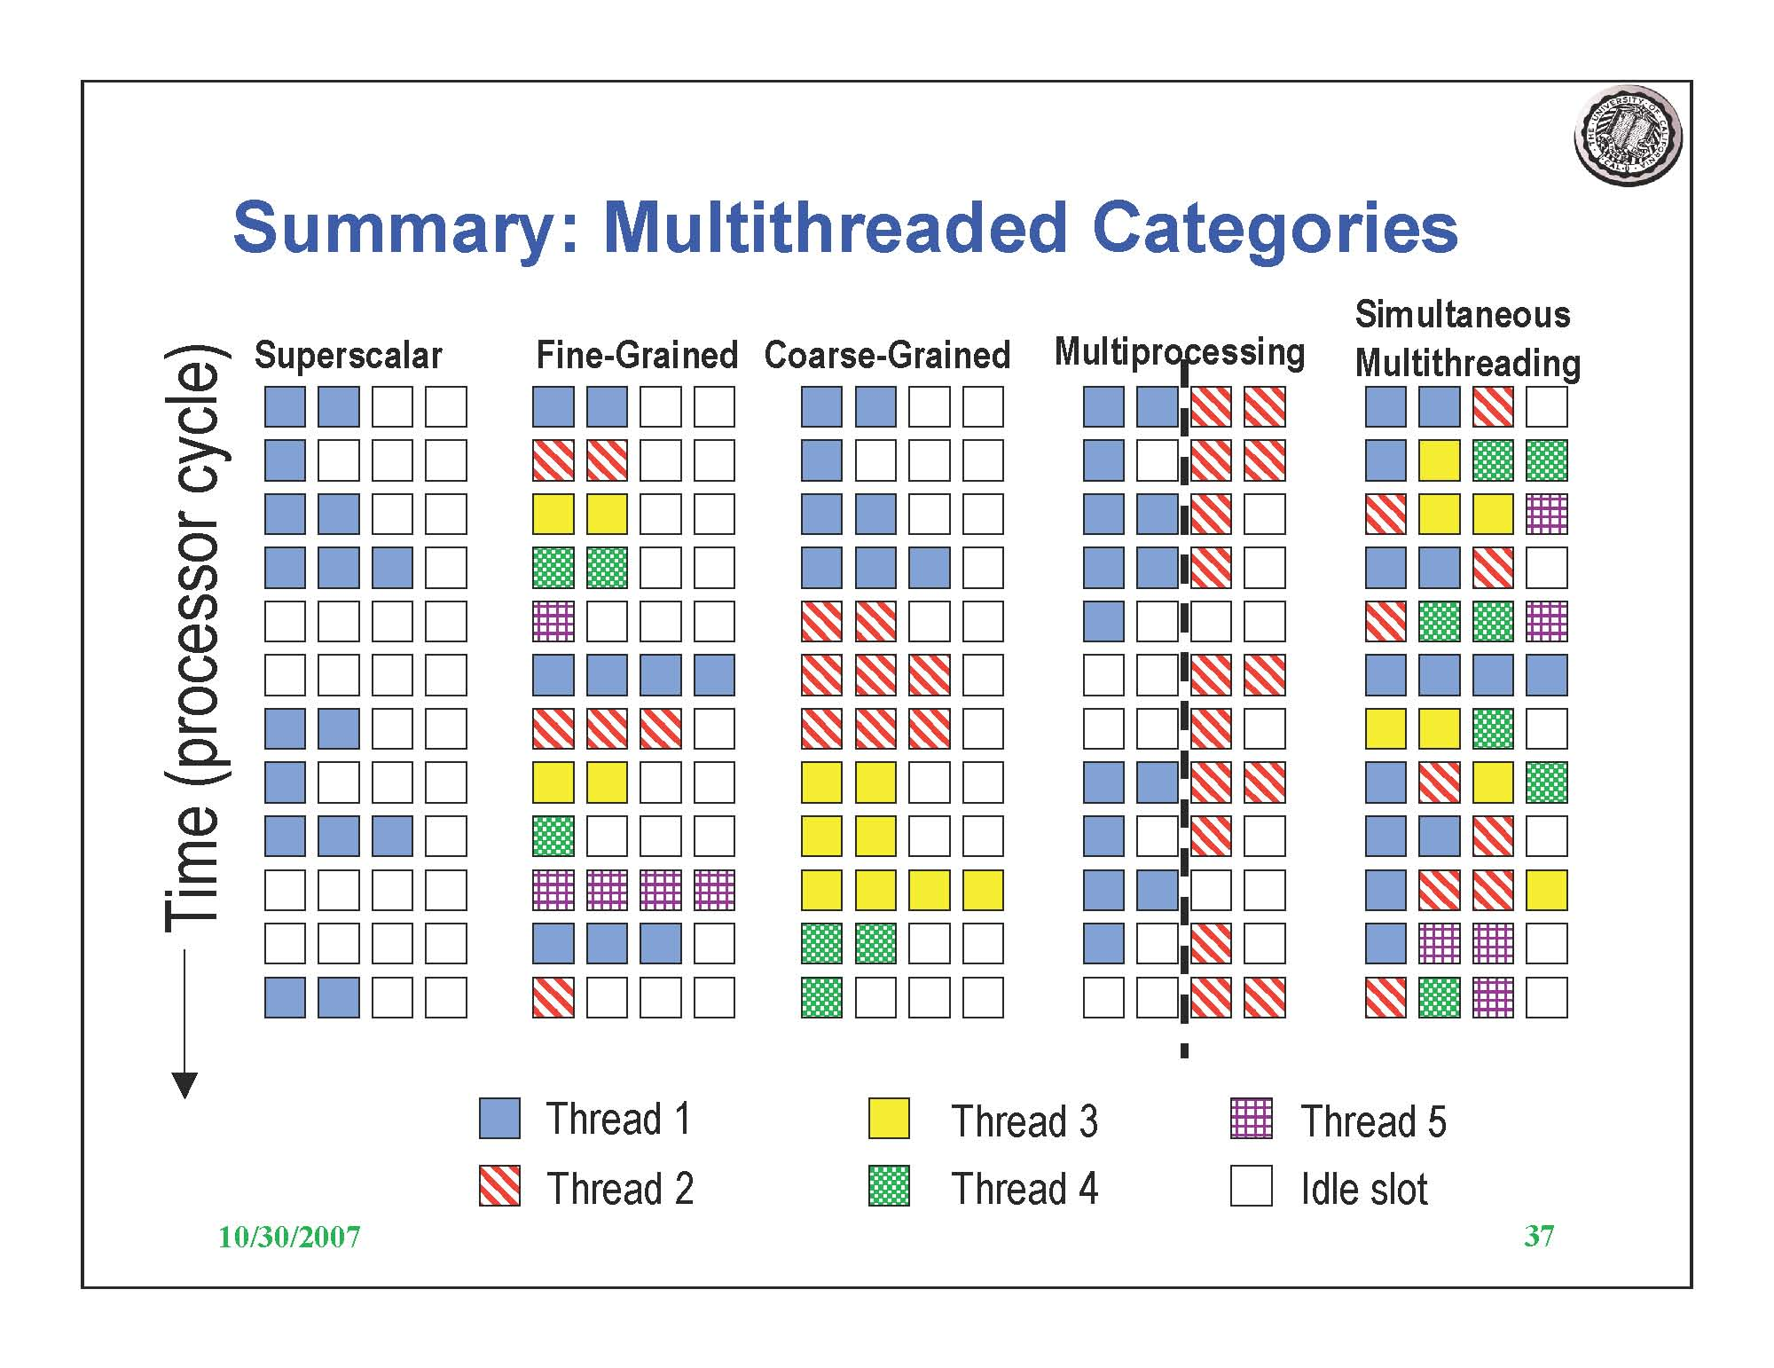
Let Us Compare

Slide 39
Software is the key…
Intel, Cisco, AMD have announced plan to come out with 80 to 256 core within a year.
The question is, what do we do with that much computational power?
256 cores would be useless, if one can’t generate 256 threads to work with.
Media applications should surely benefit from multicore.
What other applications would be necessary?
Can you name the seven Dwarfs?
It is a pattern of computation and communication.

Slide 40
They are
Phillip Collela suggested these seven original Dwarfs for high end computing
Structured Grid
Dense linear algebra
Sparse linear algebra
N-body problem
Spectral methods (e.g.FFT)
Unstructured Grid
Monte Carlo (Map reduce)

Slide 41
Some specific ones to Embedded systems
Graph Traversal
Dynamic Programming
Graphical Methods
Finite State Machine

Slide 42
So the Future is (Conclusion…)
Many Core systems with strong parallelization.
Development of parallel algorithms in the select areas.
Parallel programming is not too difficult ;-)

Slide 43
Thank you

